Slide 1

SecureTech Solutions Sales Analytics Dashboard
Transforming sales data into actionable insights across Nigeria, South Africa, Kenya, and Morocco

Slide 2

Project Overview
This comprehensive Excel dashboard empowers sales managers across four key African markets with real-time visibility into:
Total deal value segmented by country, product type, and urgency
Sales representative and regional performance metrics
High-value opportunity prioritisation
Enhanced pipeline forecasting capabilities

Slide 3
Three-Phase Development Process
01
02
03
Data Preparation
Analysis
Dashboard Development
Cleaned raw sales data including deal size, urgency levels, sales stages, and representative assignments. Created derived columns for enhanced segmentation.
Built comprehensive PivotTables analysing deal value by country, product, and urgency. Evaluated rep performance and pipeline stage breakdowns.
Designed interactive visuals with KPIs, charts, and slicers. Implemented conditional formatting for immediate insights and data-driven decisions.

Slide 4




Dashboard Features
Key Performance Indicators
Dynamic Visualisations
Total deal value, high-urgency deals tracking, and top-performing representatives identification
Bar charts, stacked columns, donut charts, and comprehensive summary tables
Interactive Controls
Advanced slicers for country, urgency level, sales representative, and pipeline stage filtering

Slide 5
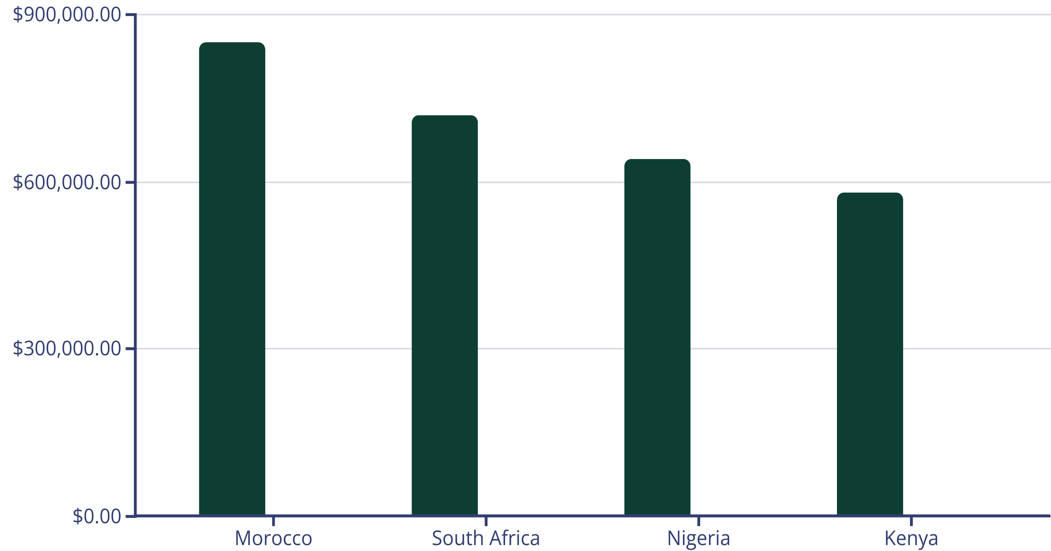
Regional Performance Analysis
Deal Value
Active Deals
Morocco leads in deal value despite having fewer active opportunities, whilst Kenya shows strong volume with emerging market potential.

Slide 6
Critical Insights Discovered
Morocco Market Opportunity
Kenya Product Demand
Exceptionally high deal values but limited sales representative coverage. Clear expansion opportunity for increased market penetration.
Significant uptick in safe deposit box enquiries suggests untapped market demand. Targeted campaign potential identified.
Rep Performance Gap
Pipeline Bottleneck
John demonstrates strong lead generation for high-value deals but struggles with closure rates. Coaching intervention required.
Multiple urgent deals remain stalled in early pipeline stages. Process optimisation and enhanced follow-up protocols needed.

Slide 7





Strategic Recommendations
Morocco Expansion
Deploy additional sales staff to capitalise on high-value market potential and established client relationships
Kenya Campaign Launch
Execute targeted safe deposit box campaign with enhanced inventory allocation to meet rising demand
Rep Development Programme
Implement focused coaching for underperforming reps whilst maintaining high lead generation capabilities
Urgency Protocol
Establish fast-track processes for urgent deals with enhanced follow-up cadence and escalation procedures

Slide 8

Measurable Business Outcomes
100%
40%
85%
Pipeline Visibility
Faster Prioritisation
Forecasting Accuracy
Complete transparency across all regional sales activities and performance metrics
Improved lead qualification based on urgency and value segmentation
Enhanced prediction capabilities for quarterly and annual sales projections
The dashboard has transformed our decision-making process, providing sales managers with unprecedented clarity into regional performance patterns and opportunity prioritisation.

Slide 9



Technical Implementation
Microsoft Excel Platform
Leveraged advanced Excel features including PivotTables, dynamic charts, interactive slicers, and sophisticated conditional formatting rules
Data Processing
Combined manual validation with formula-based cleaning to ensure data integrity and accuracy across all regional datasets

Slide 10



Ready to Scale
This dashboard framework is now deployed across all four markets, providing SecureTech Solutions with the analytical foundation needed to drive strategic growth and optimise sales performance continent-wide.

